Slide 1

Node.js 簡介
http://nodejs.org/
WebServer v.s. Apache
Javascript (Chrome v8 engine)
event-driven
non-blocking I/O
Asynchronous 非同步
Notes:
簡介備註。

Slide 2


Web Application
Server
MySql (SQL)
PHP
Asp.NET(C#, VB)
Sql Server (SQL)
Node.js
MongoDB (NoSQL)
Internet
JavaScript
JavaScript

Slide 3
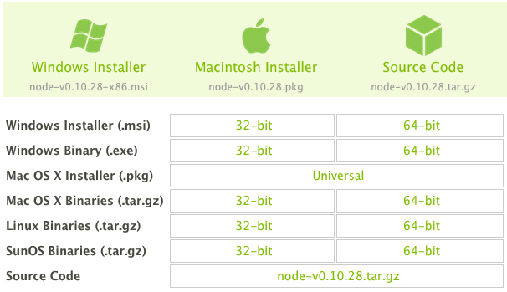
Download and Install Node.js
http://nodejs.org/download/

Slide 4
Non-blocking
//block
var result= fs.readFileSync("file1");
console.log(result);
console.log("do something");
//non-blocking
fs.readFile ("file1", function(err, result){
console.log(result);
}
console.log("do something");

Slide 5
Node.js Hello World!
var http = require('http');
http.createServer(function(req, res){
res.write("Hello World!");
setTimeout(function(){
res.end();
}, 5000);
}).listen(8080); //http port
file: server.js
var http = require('http');
http.createServer(function(req, res){
response.write("Hello World!");
response.end(); //close connection
}).listen(8080); //http port
console.log('Now, listening on port 8080');
執行 server.js 啟動http Server
>node server.js
Client 端 瀏覽器
http://localhost
http://md.nutc.edu.tw (domain name)

Slide 6
Express: Node.js網頁伺服器
//server.js
var express = require("express");
server = express();
server.get("/",function(req,res){ //web root
res.send(“Hello, World!”); //回傳固定內容
});
server.get("*",function(req,res){ //other pages
res.send("Page not found", 404);
});
server.listen(8080);
console.log("Express run on port: 8080");
//run: node server.js
//browser: http://localhost:8080

Slide 7
Node.js Package Management
npm: https://www.npmjs.com
列出目前已安裝的套件
npm list
使用套件: http
var http=require('http');
使用套件: mongodb or mongoose
var mongo = require("mongoose");
若未安裝套件，使用npm 進行安裝:
> npm install mongoose
> npm install express
Global: (node.js程式在任何目錄都可找到該套件)
npm install –g mongodb
使用多個套件?

Slide 8
package.json
{
“name”: “myFirstServer”,
“version”: ”0.0.0”,
“description”: “Learning Node.js”,
“main”: “server.js”,
“dependencies”: {
“mongoose”: “~1.3.10”,
“express”: “~3.2.6”,
“consolidate”: “~0.9.1”
},
“author”: “kfhwang”,
“license”: “MIT”
}
建立package.json: 終端機輸入npm init
package.json與主程式app.js置於同一目錄下
npm install 檢查套件mongodb, express, consolidate是否已安裝，並自動進行安裝在app.js所屬目錄下

Slide 9
Express and Html
//將html 原始碼放在send中，不實用
server.get('/about', function(req, res, next) {
res.send('<html lang="en"><body>Page About! </body></html>');
});
//將html檔放在public資料夾
server.use(express.static('public'));
練習將網頁放到NodeJS建立的伺服器上

Slide 10
Express: Handling GET Requests
var express = require('express’) , server = express();
// Handler for internal server errors
function errorHandler(err, req, res, next) {
console.error(err.message);
res.send ('Server Error!');
}
server.use(errorHandler);
server.get('/:name', function(req, res, next) { //localhost:8000/Tom
var name = req.params.name;
res.send('Hello '+name);
});
server.listen(8000, function(err){
if(err) throw(err);
else
console.log('Express server listening on port 8000');
});
//重要: client送資料到伺服端，get協定是串在url後面, 例: ?score=999&name=MD

Slide 11
Express: Handling POST Requests
server.get("/",function(req,res){
res.send("Node App Server is running");
});
var bodyParser = require('body-parser');
server.use(bodyParser.urlencoded());
server.use(bodyParser.json());
server.post("/favourite", function(req, res, next){
var favorite = req.body.fruit;
if(typeof favorite == 'undefined'){
next(Error("Please choose a fruit!")); //to next route
}
else
res.send("Your favourite fruit is"+favorite);
});
Post送資料到伺服端是用參數，非串在URL後面
測試以Post等協定上傳的工具: Advanced REST Client for Chrome

